Slide 1
“FROM HEALTHY EGGS TO THE DINING TABLE.” Safe, premium quality, industrial produced Norwegian Atlantic Salmon and Fjord Salmon.
Mr. Morten Tangen,
CEO SINOR AS
Beijing 16th of September 2012

Slide 2
NORWEGIAN ATLANTIC SALMON

Slide 3
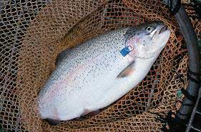
Norwegian Fjord Salmon

Slide 4
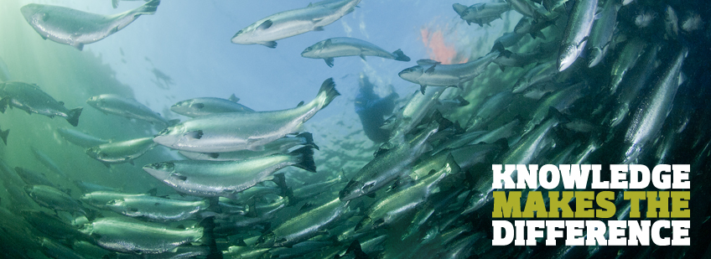
KNOWLEDGE

Slide 5
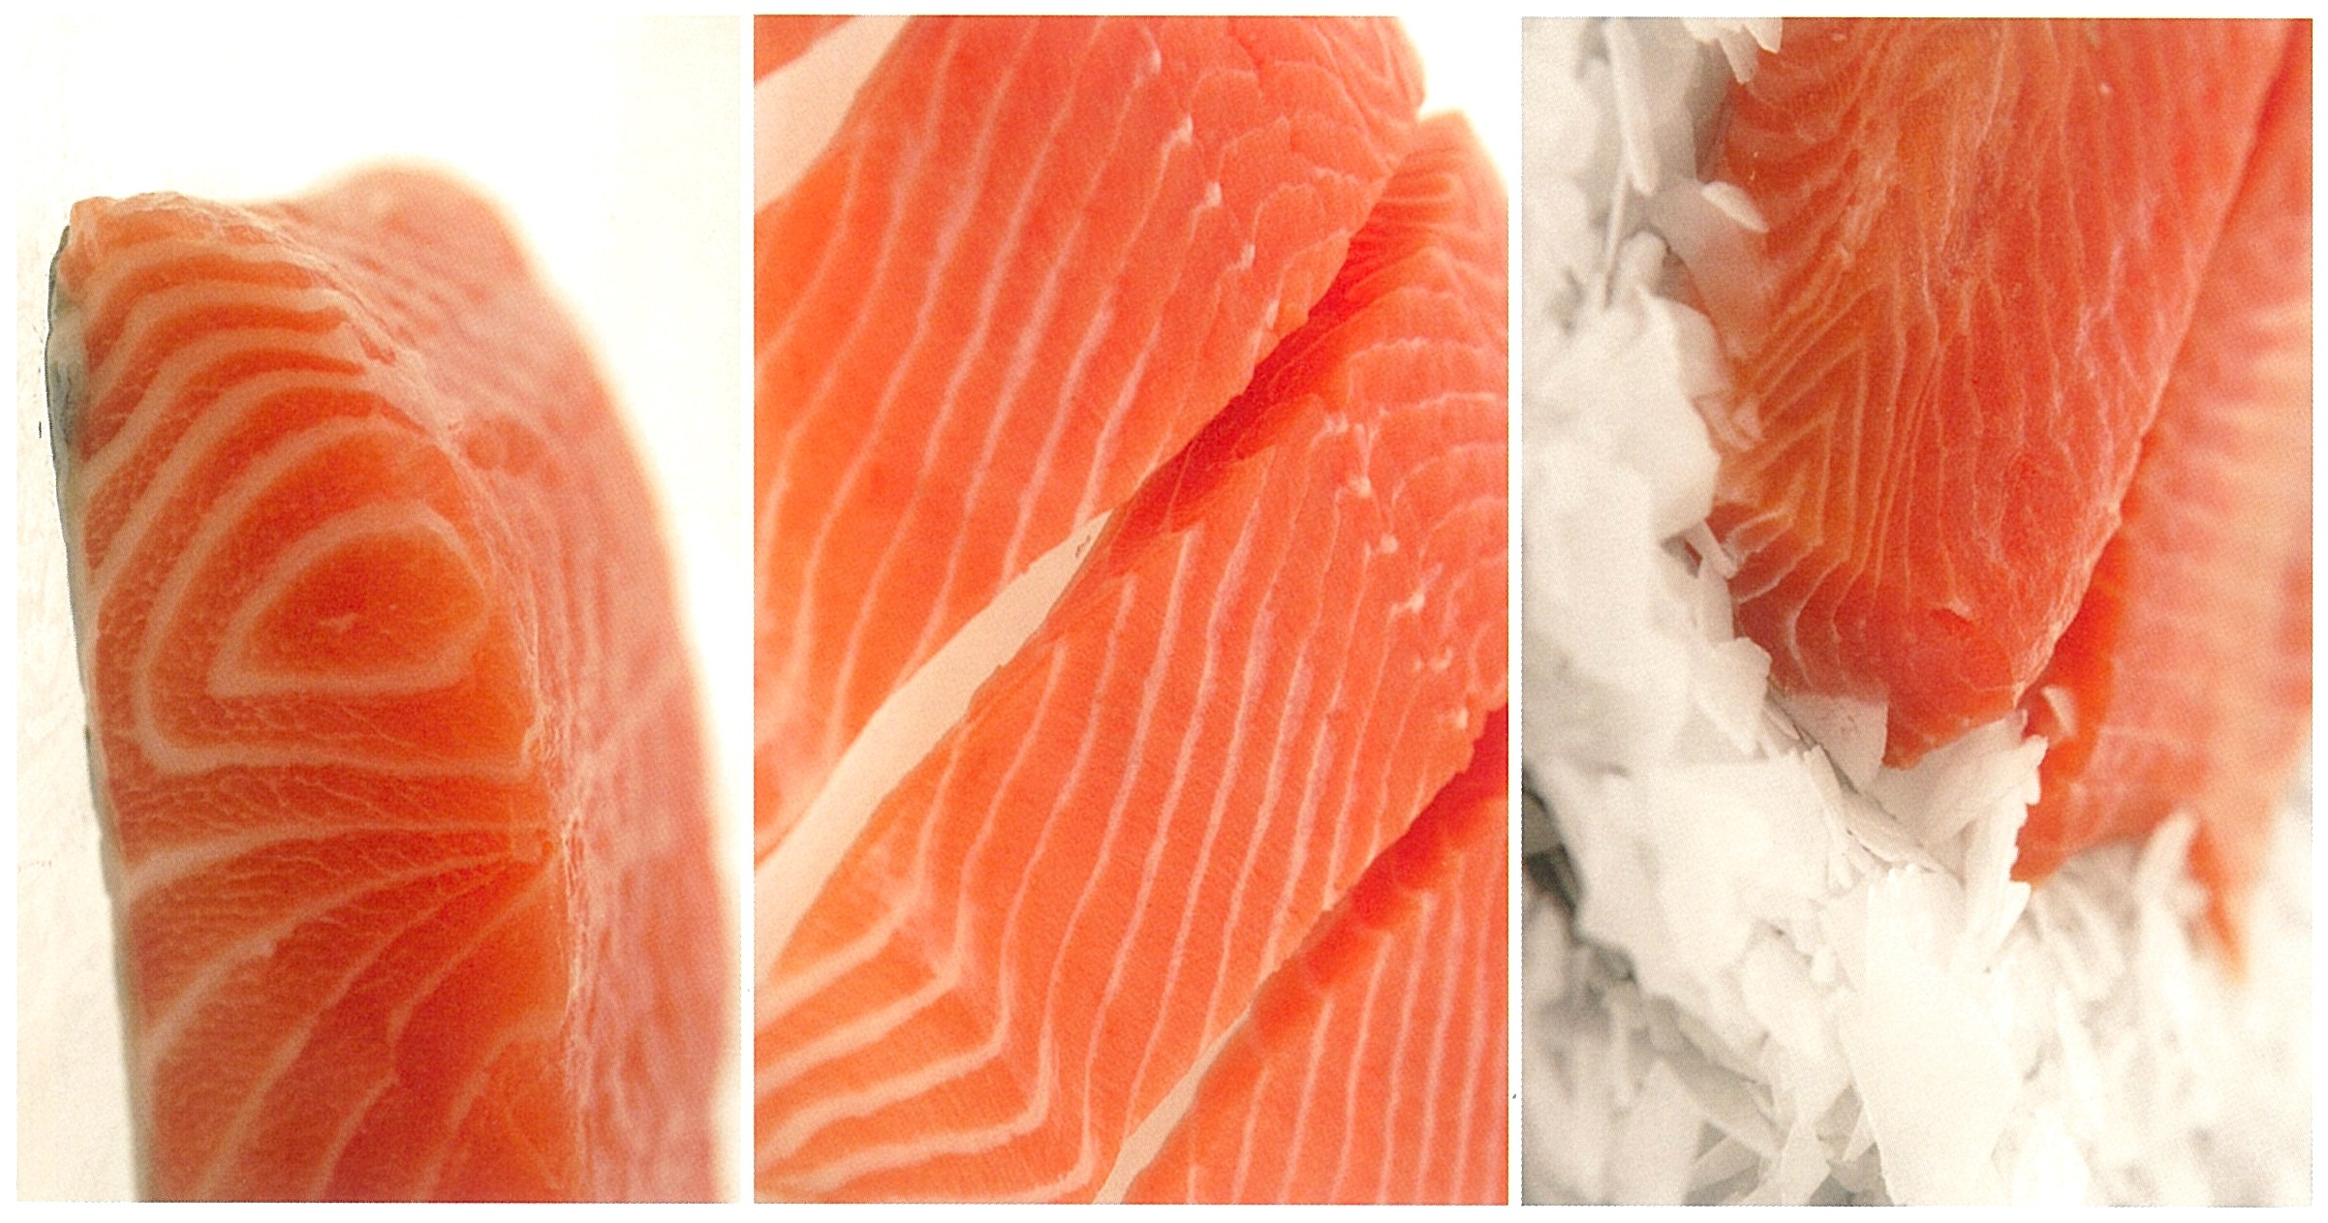
DIFFERENT SALMON QUALITIES

Slide 6
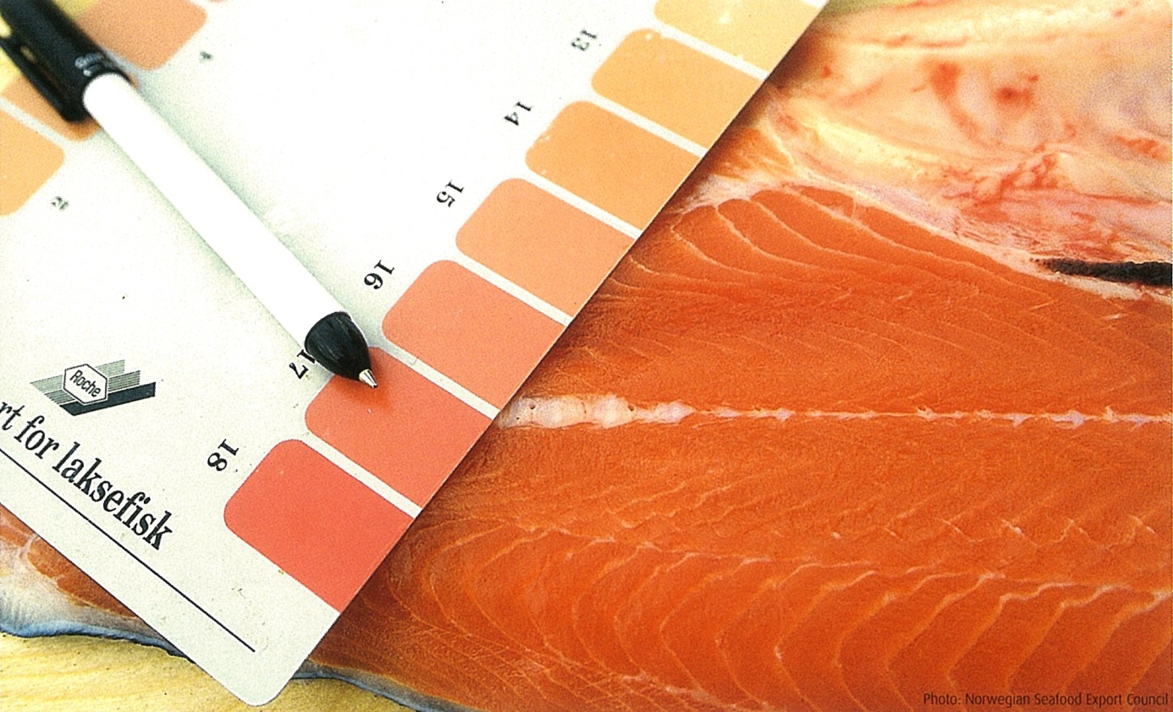
NATURAL COLORS REPLICATED

Slide 7
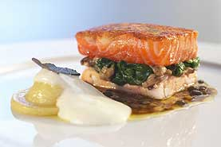
FJORD SALMON – NORWEGIAN WAY

Slide 8
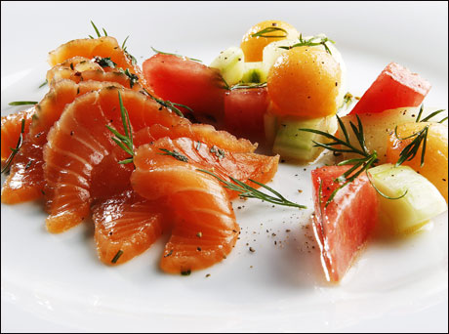
NORWEGIAN ATLANTIC SALMON

Slide 9
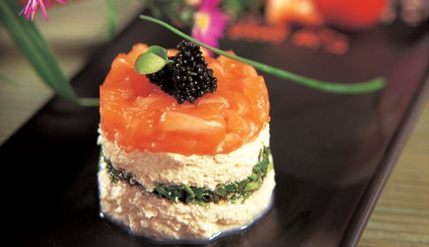
SALMON TOFU – CHINESE RESTAURANT

Slide 10
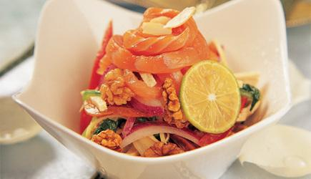
Dr.stimulerer appetitten, gjør huden vakker og er ernæringsmessig velbalansert.
Dermatologist Dr. Wu Yan, at BUH, calls this dish;
”YOUNG & CHARMING PRINCESS..
– perfect nutrition that enhances the beauty of the skin.”

Slide 11
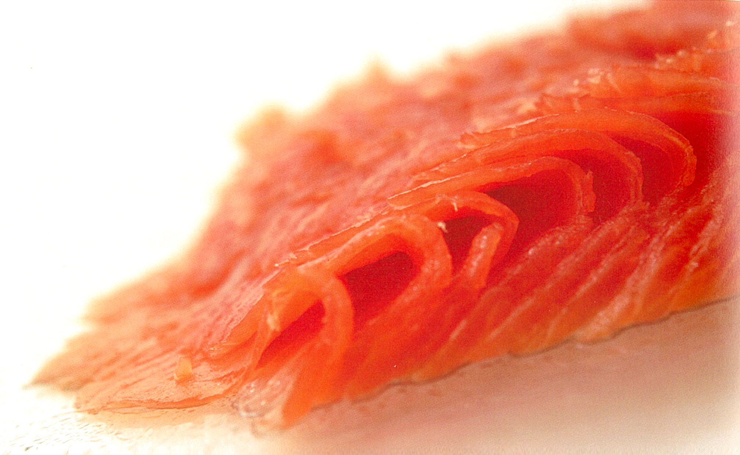
FJORD TROUT - SASHIMI QUALITY

Slide 12
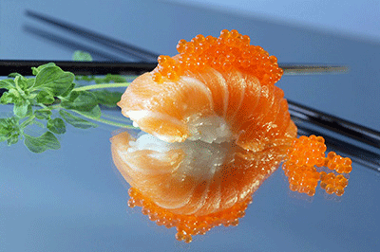
ATLANTIC SALMON – A FAVORITE SUSHI

Slide 13
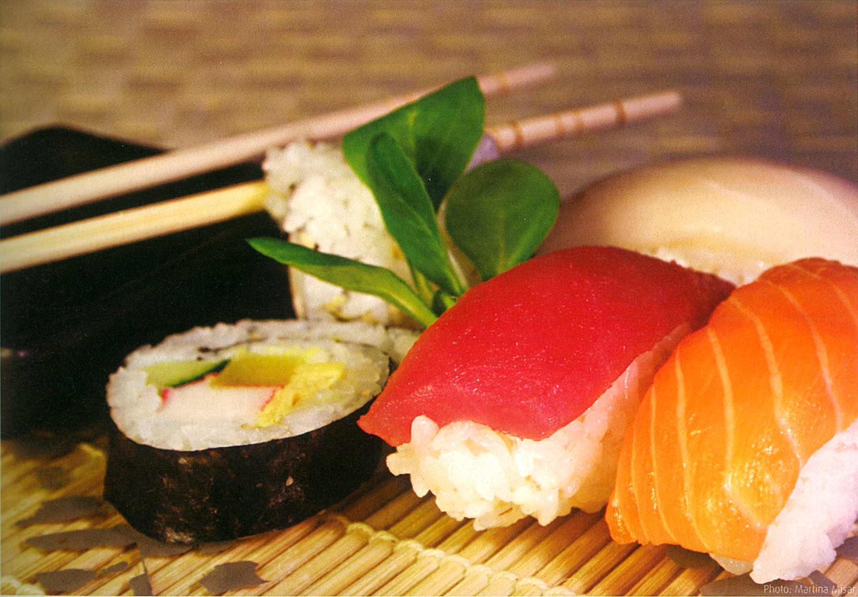
QUALITY SUSHI

Slide 14
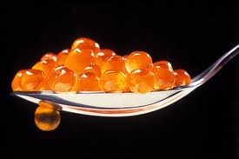
CRUNCHY SALMON EGGS – CAVIAR

Slide 15
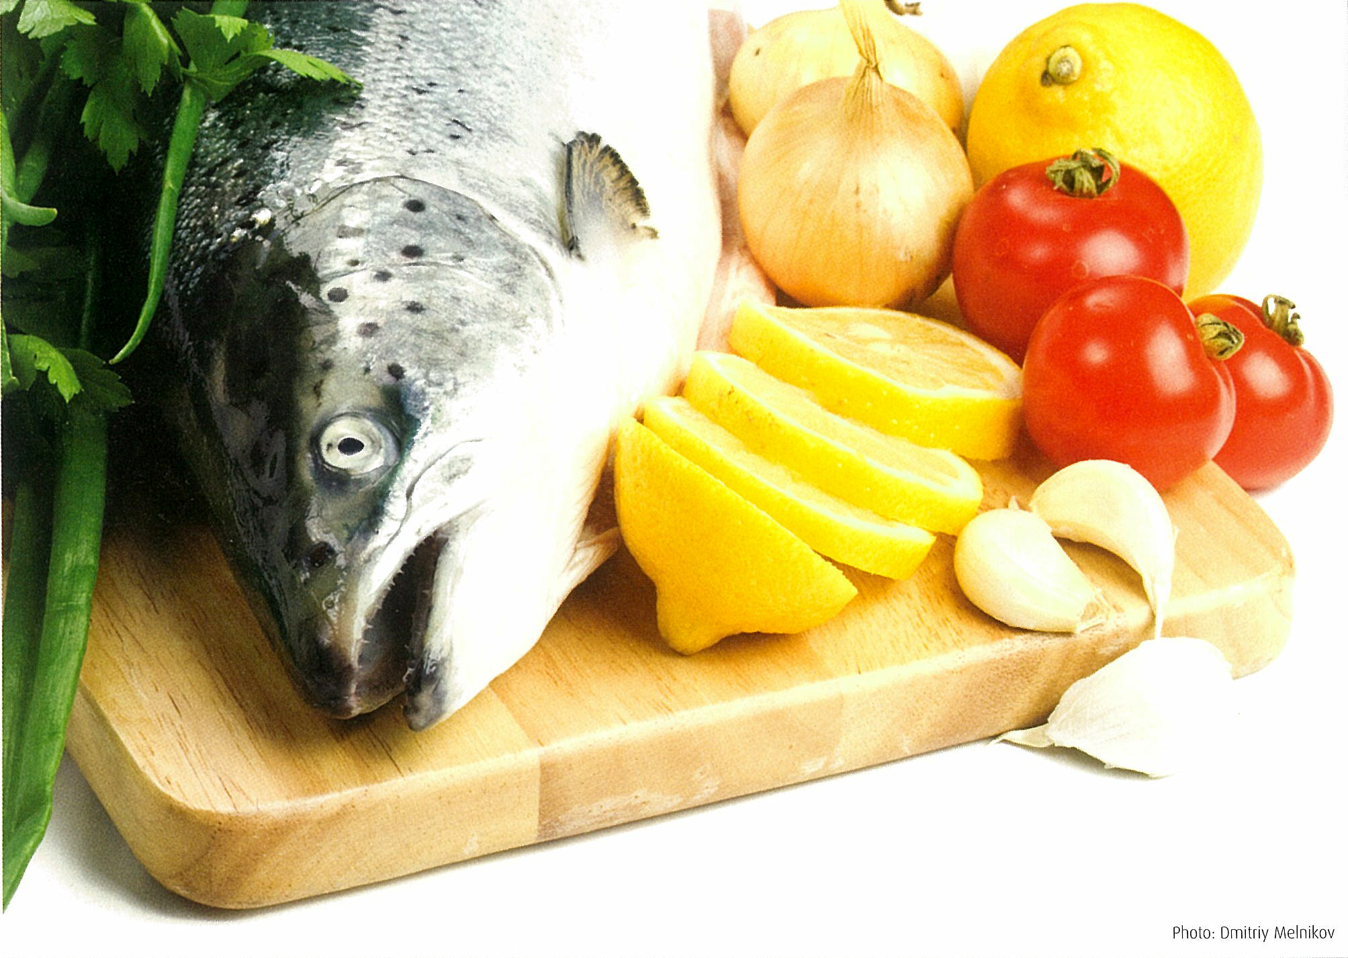
ONE FISH BECOMING FAMOUS

Slide 16
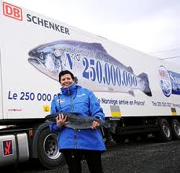
FROM COMMODETY TO INTERNATIONAL BRAND

Slide 17
WHY ATLANTIC SALMON ?
NORWEGIAN ATLANTIC SALMON is the most attractive, identifiable and accepted fish on color, texture & taste by both children and adults
Offering an excellent source of nutrients
Increased consumption of omega 3 rich fish is linked with reductions in cardiovascular diseases, strokes and some type of cancer and has positive effects on the immune system.
.

Slide 18
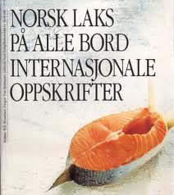
MARKETING
Billion of NOK invested in international marketing.
World wide logistics.
“One fist” - not 5 fingers.
All year supply
Traceability
Standardization
Governmental inspection & enforcement
Safe & Healthy – building;
CONSUMER TRUST

Slide 19
CONSUMER TRUST
CHASING;
QUALITY,
QUALITY,
QUALITY……
AS DEFINED BY THE CONSUMER;
SAFE- HEALTHY- RICH IN FLAVOUR - AFFORDABLE

Slide 20
THE NORWEGIAN SALMON SUCCESS:
Three main factors:
In 2010 the production of Atlantic salmon and fjord salmon was approximately 1.3 million ton – equivalent to only 2.5% of farmed sea food world wide.
Yearly export value exceeding RMB 30 billion.
Currently exported to more than 60 countries.

Slide 21
WHAT IS THE SUCCESS HISTORY?
IT WAS NOT ALWAYS A SUCCESS!
THE SUCCESS DID NOT COME FOR FREE!

Slide 22
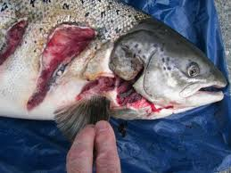
Some 20 years ago……

Slide 23
What happened……?
Too small off shore production units.
Insufficient farmer competence
Very intensive farming
Low level of hygiene
Lacking veterinarian skills.
Heavy antibiotics treatments.
Feed & breeding limitations.
Lack of comprehensive management approach.
Break down of markets.
Bankruptcies

Slide 24
INDUSTRIAL TURN AROUND STRATEGY:
Cooperation between government & industry
Introduction of target legislation
Intensified investment and scope of research
Industrial consolidation; from 1.200 farmers to 10 major companies.
Tractability & accountability.
Redesign of production facilities – focus on environment
Implementation of Health & Safety programs.
Gradual abolishment of antibiotics.
Increased specialisation of complimentary service industries

Slide 25
INTERNATIONAL SUSTAINABILITY - ECOLOGY FOTO: SKRETTING

Slide 26
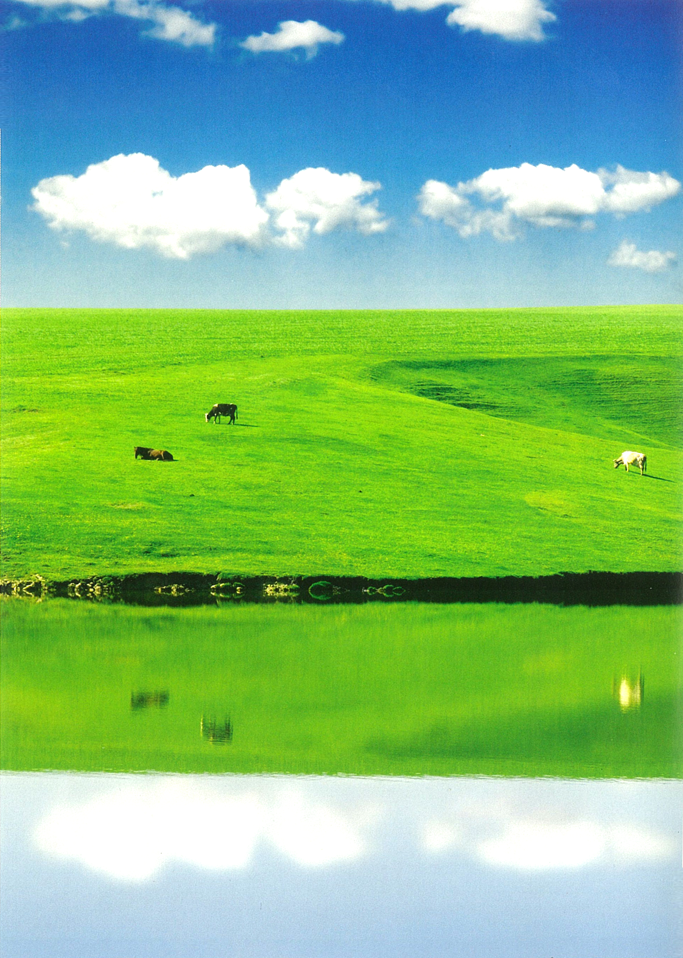

Slide 27
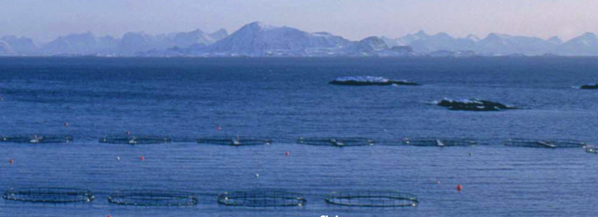
FROM ECOLOGY TO BLUE ECONOMY

Slide 28
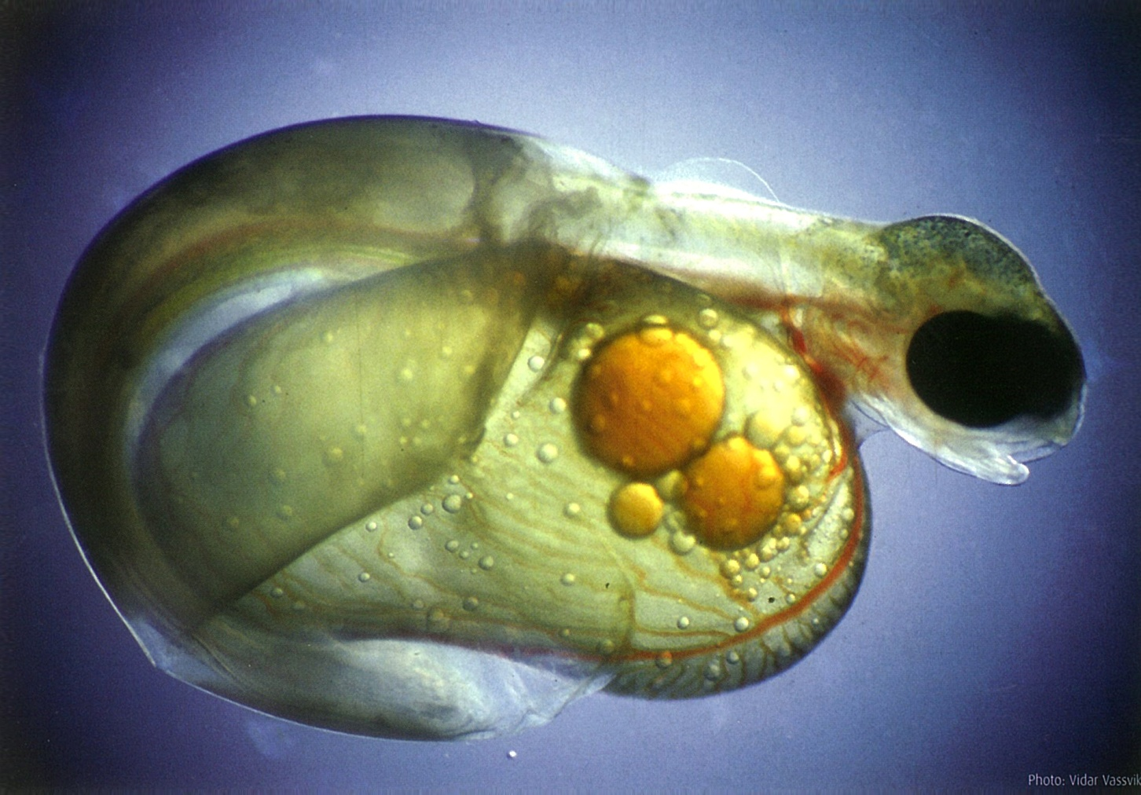
BLUE ECOMOMY – SUSTAINABILITY

Slide 29
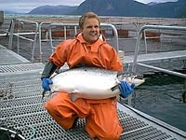
25 kg of PREMIUM SALMON

Slide 30
GENERAL BACKGROUND
Before 2025, the World Population will exceed 10 billion people
Depending on certain assumptions about affluence, diet composition and food waste the calculations imply an increase in total food production of 70% on current production level during the same period.

Slide 31
GENERAL BACKGROUND
The majority of this population will be urbanized.
The importance of nutrient, safe, healthy sea food will play an increasingly important role for both the society and the consumer.
Sustainability is a global challenge

Slide 32
THE PROSPECT OF THE BLUE ECONOMY
Total fish demand is likely to increase significantly.
Sea-caught fisheries will be conservation-managed to seek to maintain present levels of production.
Aquaculture production will continue its ongoing trend to provide a larger proportion of total fish production.
Total fish consumption per head will increase for health reasons.

Slide 33
Land Based PRODUCTION of SALMON – REASERCH led to R.A.S. TECHNOLOGY…
Profitable
Control of all production parameters
Closeness to market – new distribution opportunities
Sustainable
Environmentally safe - waste treatment represents substantial incremental earnings
Comprehensive monitoring and production control
Premium quality, product development – and pricing
Technology driven
Traceable quality parameters
Substitutes 60 % of import value for salmon products
Represents Export potential

Slide 34
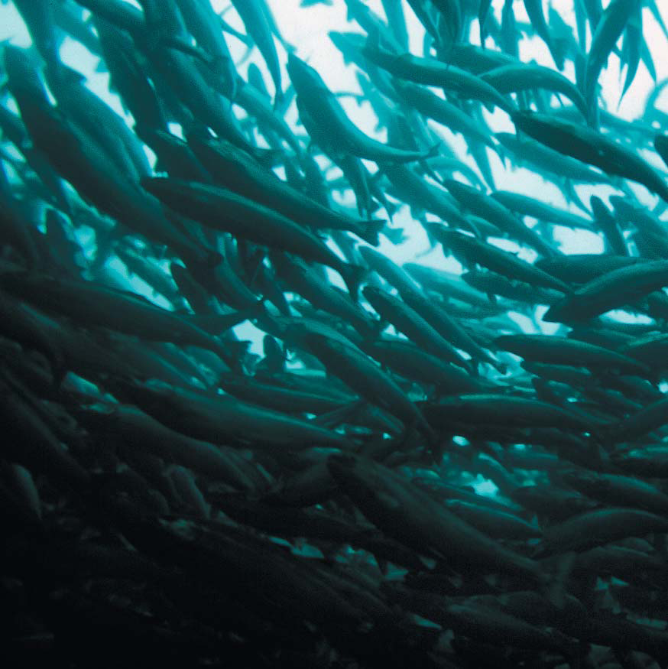

Slide 35
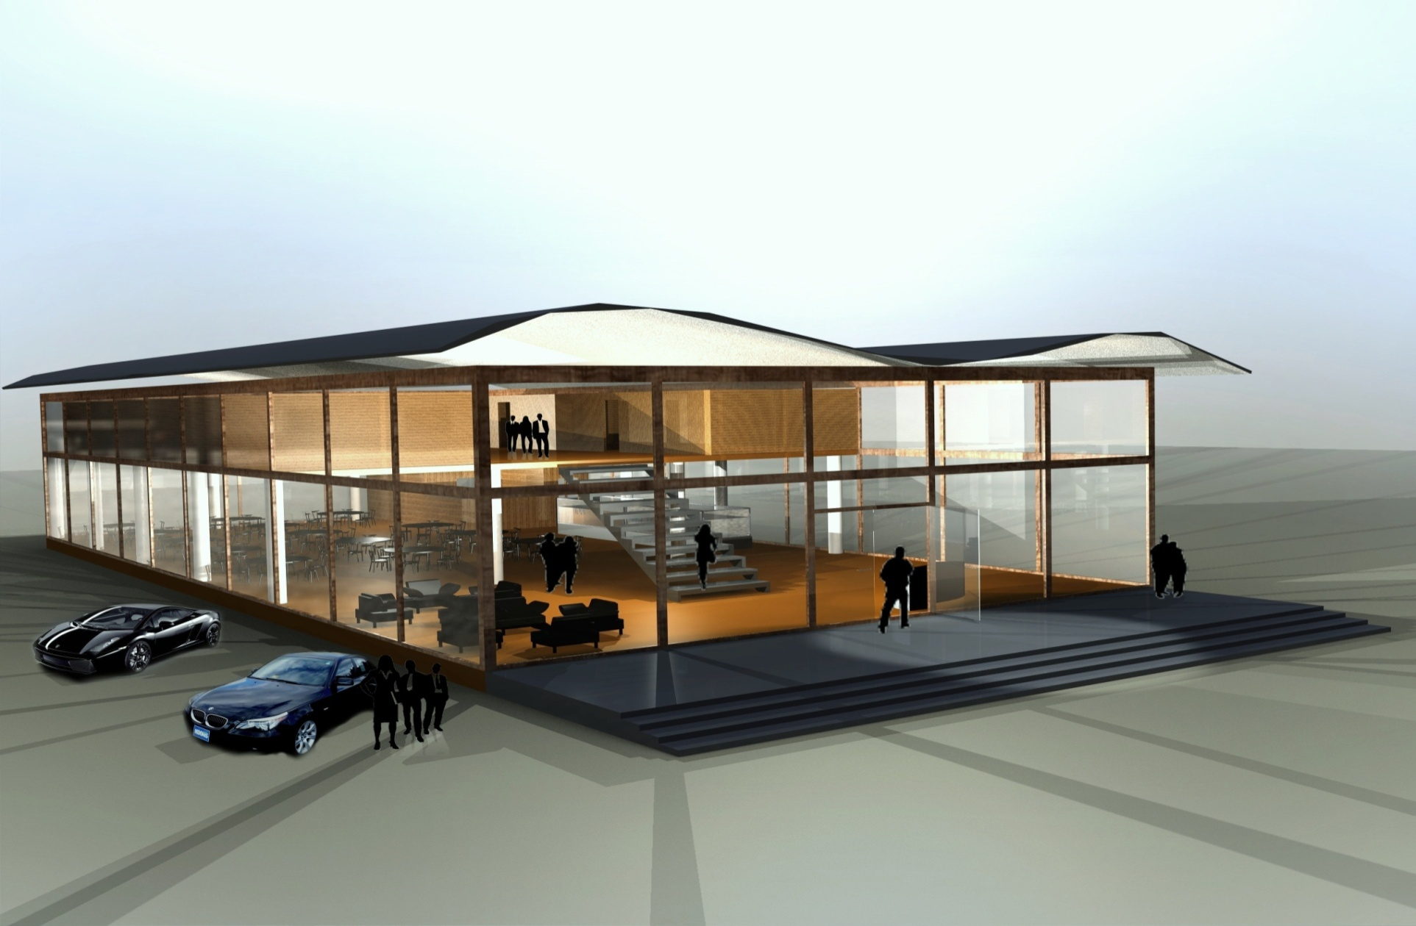

Slide 36
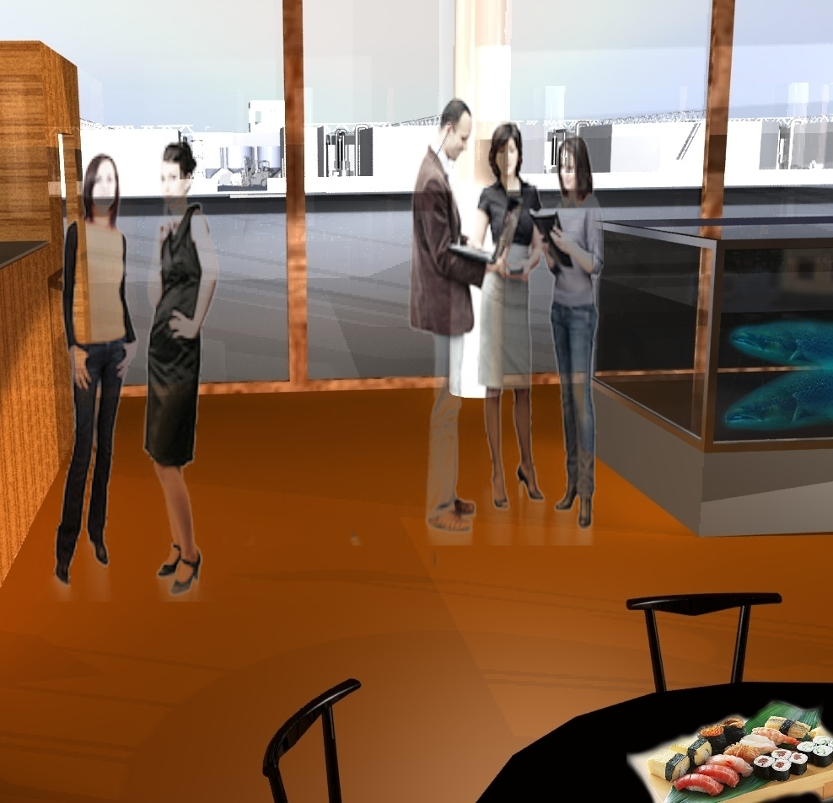

Slide 37
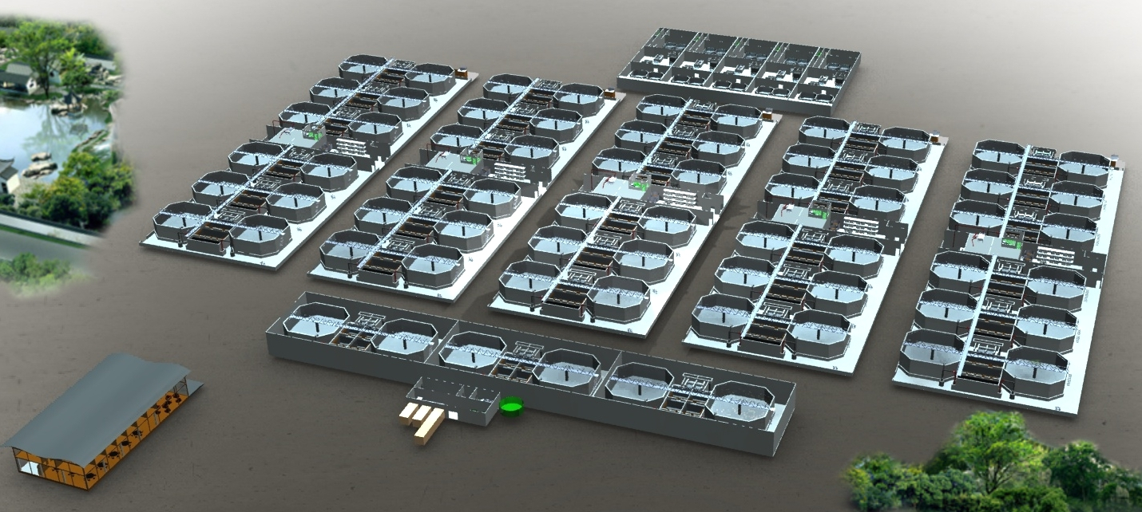
R:A.S.NO TOUCH PRODUCTION LAY OUT

Slide 38
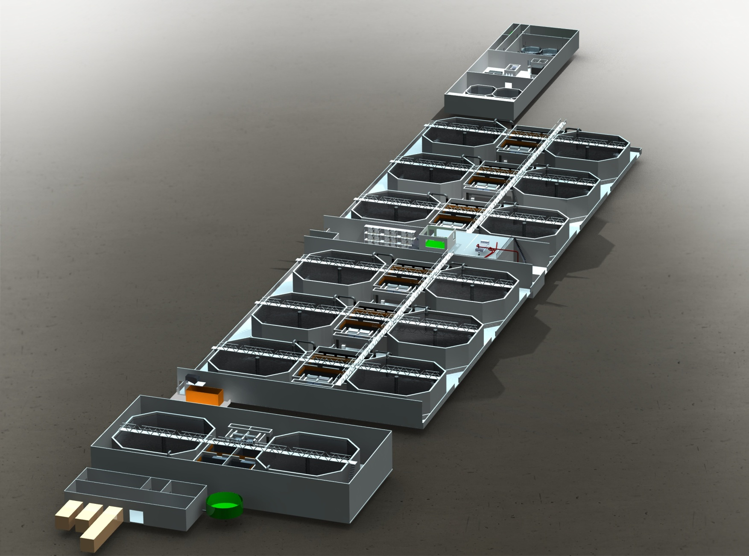
Modular unit producing 1.000 MT/year.

Slide 39
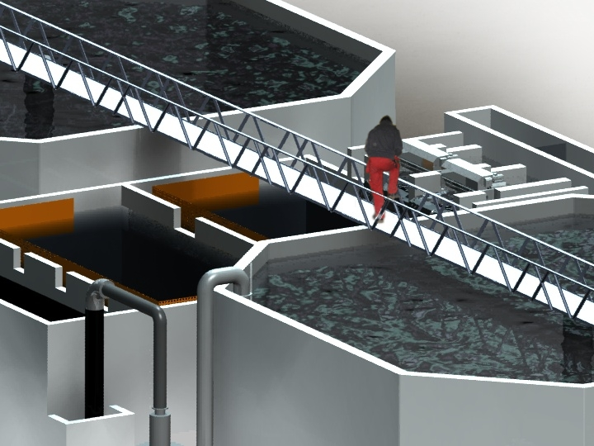

Slide 40
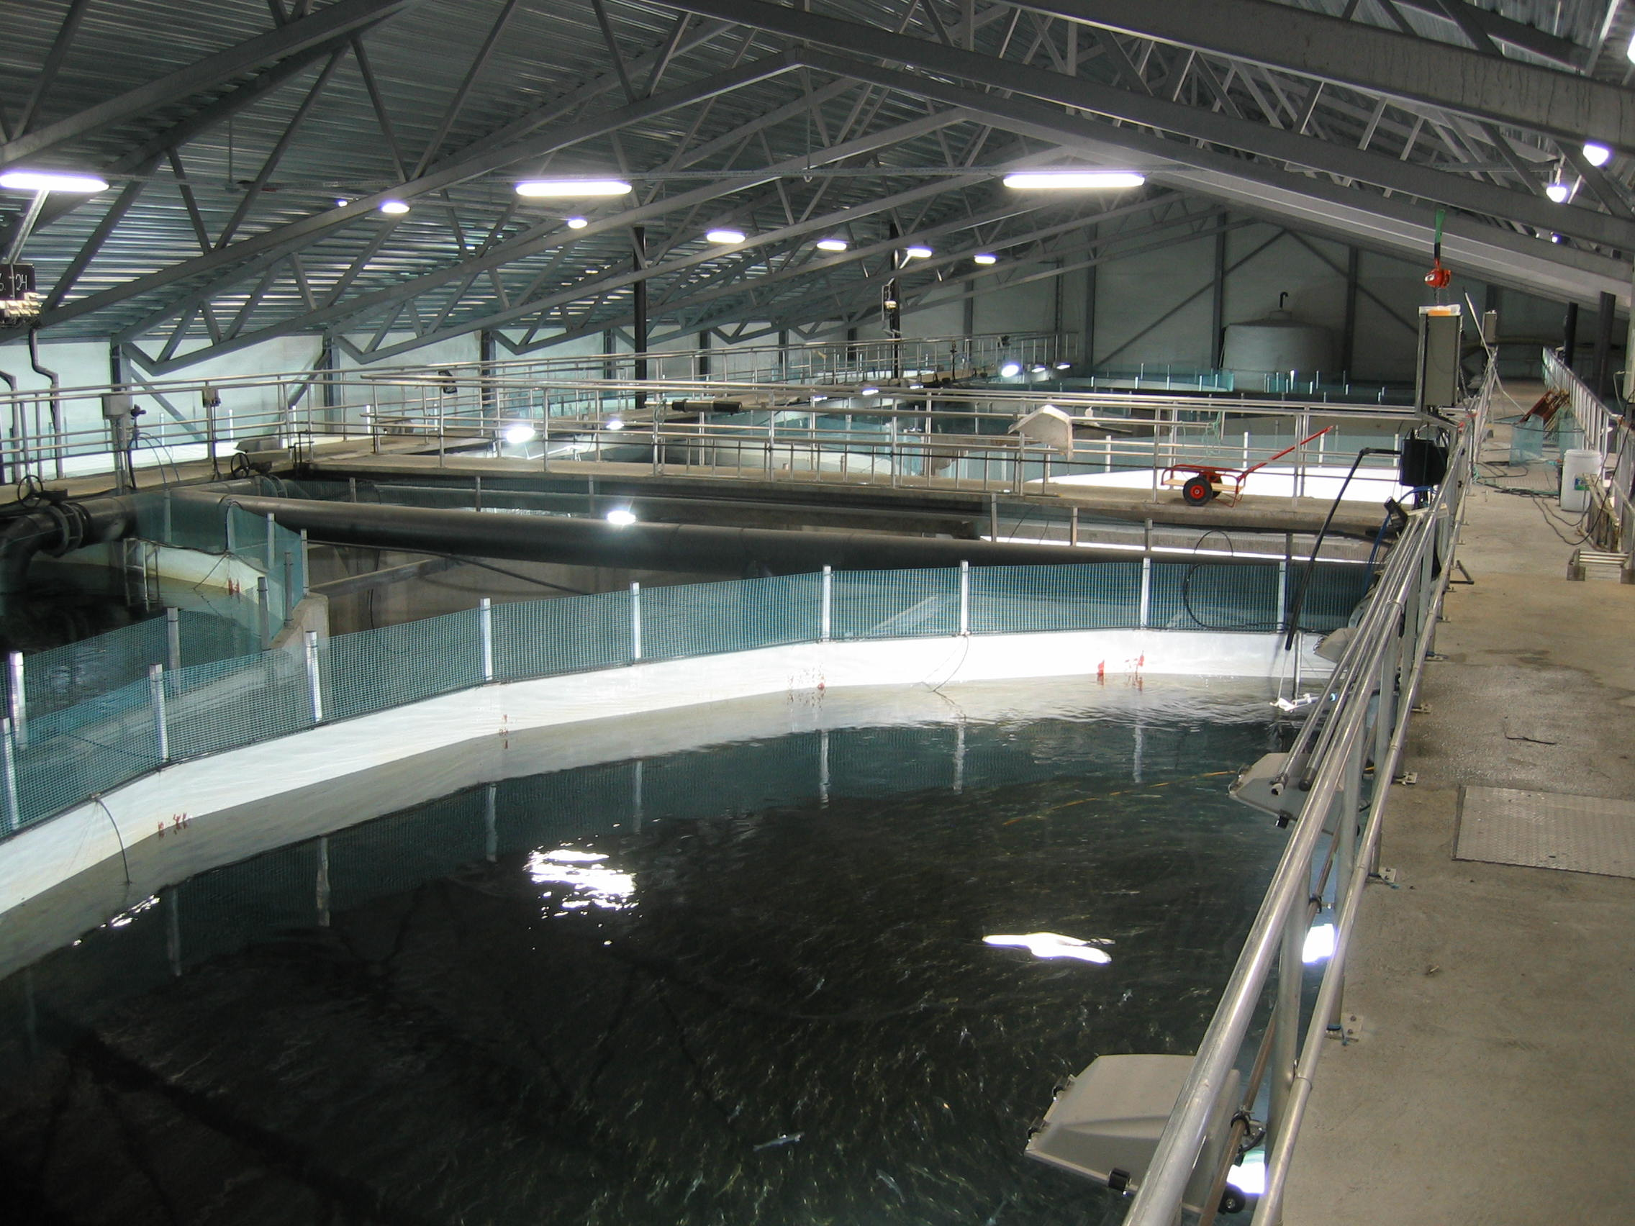
SALMON FRESH WATER R.A.S.

Slide 41
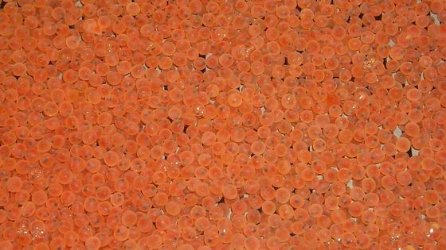
SECURE & GUARATEED SALMON EGGS
Fertilized salmon eggs

Slide 42
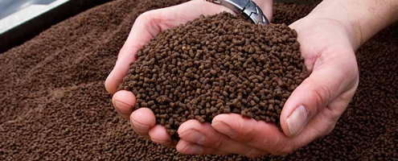
Fjord Salmon and Salmon Feed

Slide 43
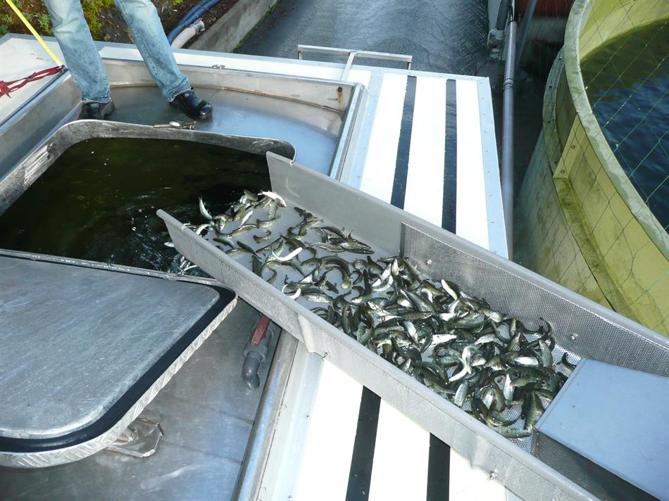
TRANSPORTATION OF LIVE SMOLT – salmon & fjord salmon

Slide 44
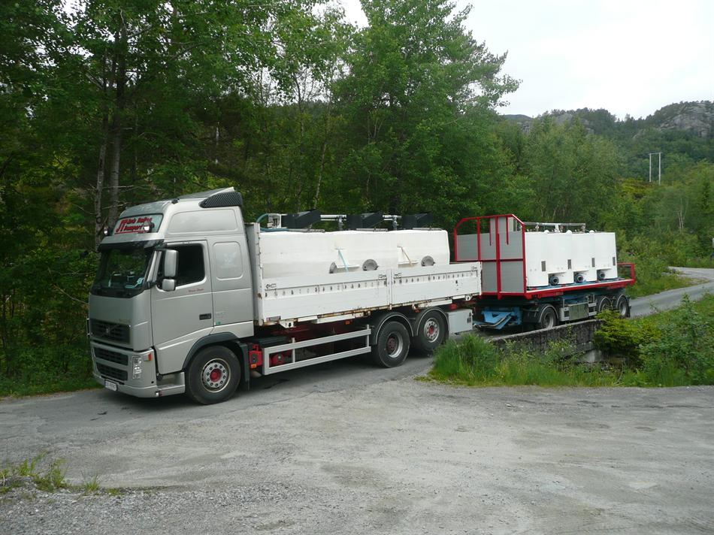
TRANSPORTATION OF LIVE SMOLT – salmon & fjord salmon

Slide 45
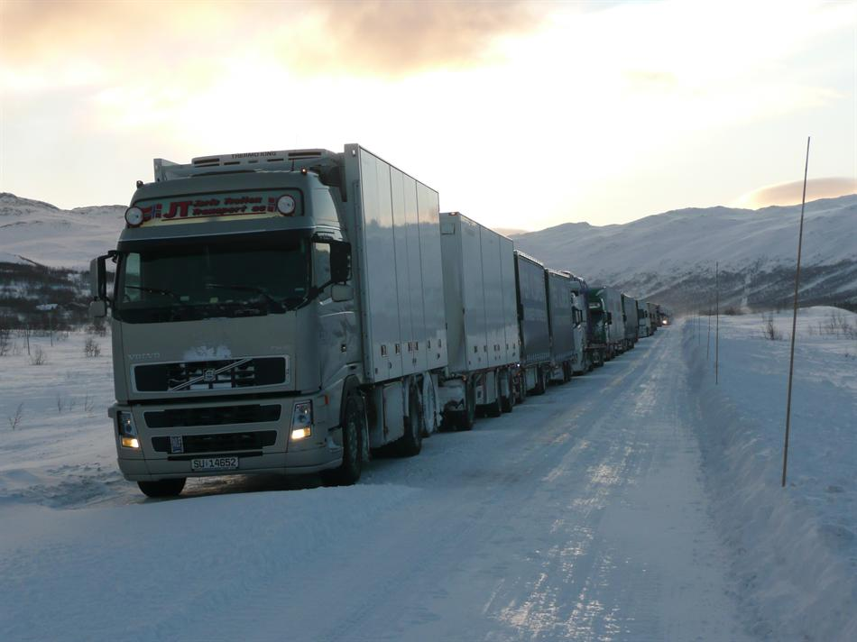
TRANSPORTATION OF LIVE SMOLT – SALMON & FJORD SALMON.

Slide 46
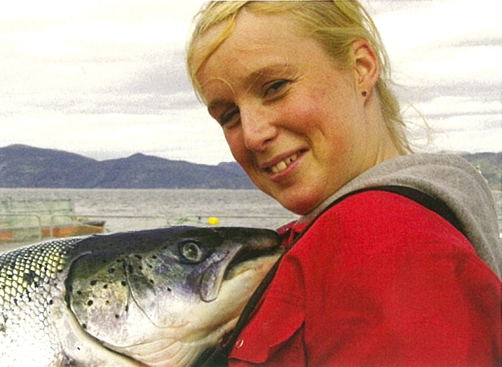
NATURAL, HEALTHY & SEFAE

Slide 47
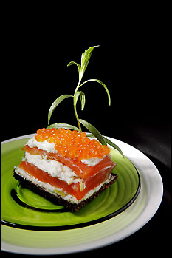

Slide 48
CRITICAL ISSUES in industrial R.A.S. production;
Sweet Water quality
Salt Water quality
Water temperature
Water analysis
Feasibility studies
Location/land specification
State of the Art Technology and applied R.A.S. design
Biological Expertise
Equipment - Processing
High-tech & detailed Engineering
Project Management
Disease control & Vaccination – Salmon Doctors
Professional OPERATIONAL MANAGEMENT
Operational Training
Distribution
Waste Handling

Slide 49
Innovation and Technology: The future of Aquaculture!
General aquaculture trends for technology, feed and genetics;
More highly specialized partners
Strict market demands (traceability and information)
More specialized solutions
Veterinarian solutions
The industrial development
Natural conditions, including natural resource management
International legislation
Integrated operations
Development of Technology and knowledge
Applied technology from other industrial sectors
Engineering innovation
Prediction models & operation laboratories
Process control & surveillance
Virtual training
Information & communication
Automation, robotic production, sensor technology
Outsourcing

Slide 50
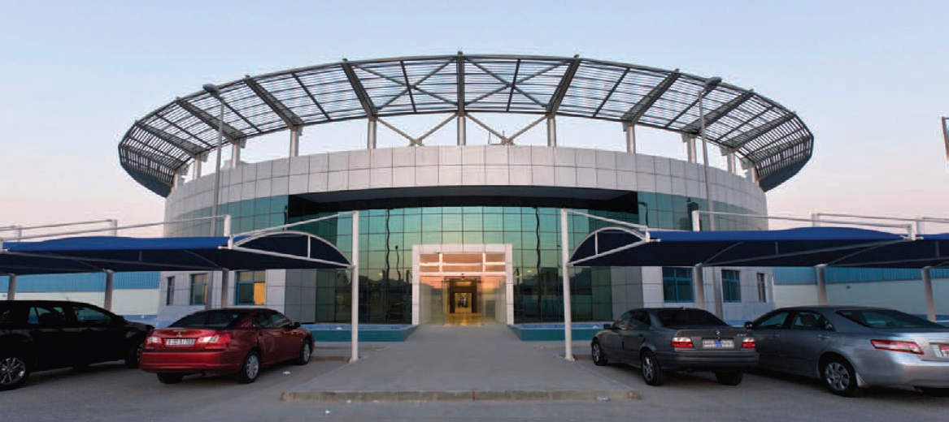
The largest R.A.S. STURGEON PLANT

Slide 51
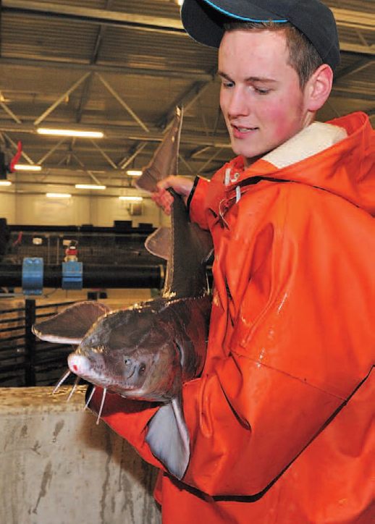

Slide 52
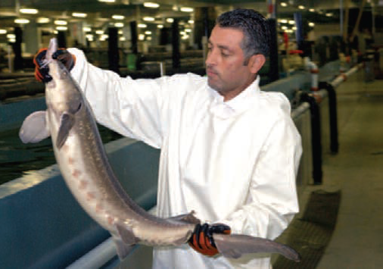
A USD 100 mill STURGEON R.A.S. PLANT

Slide 54
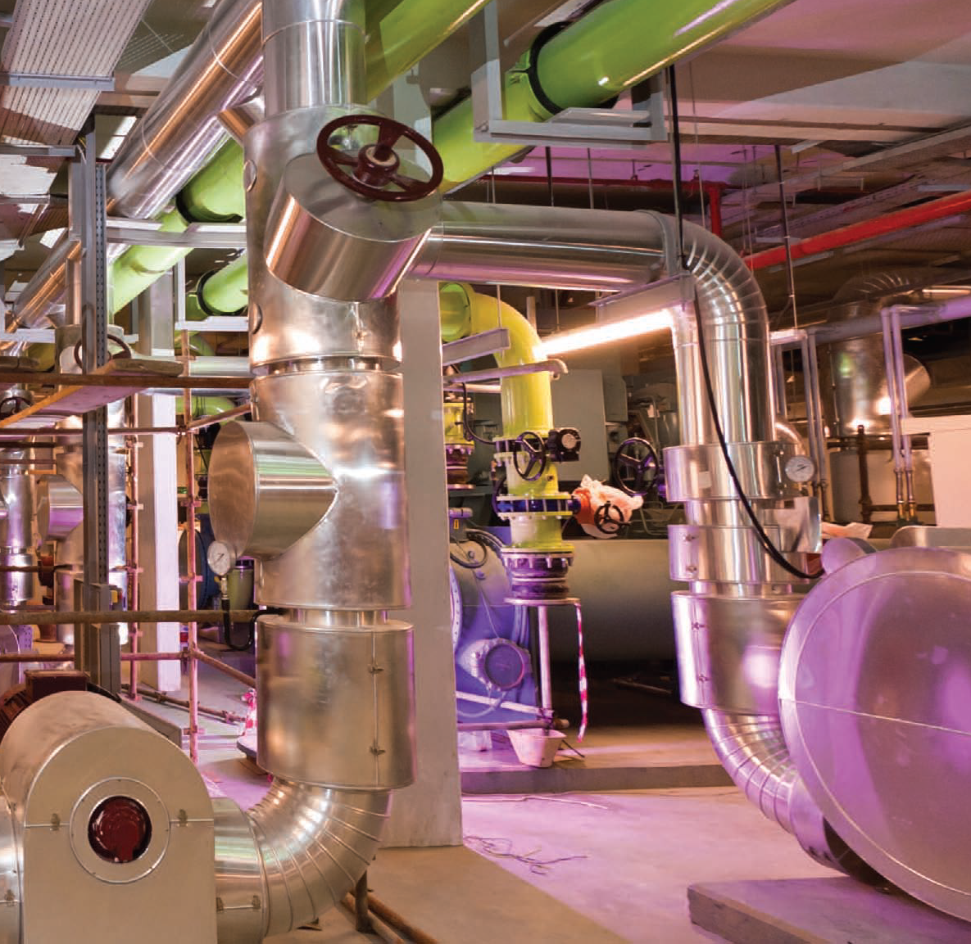

Slide 55
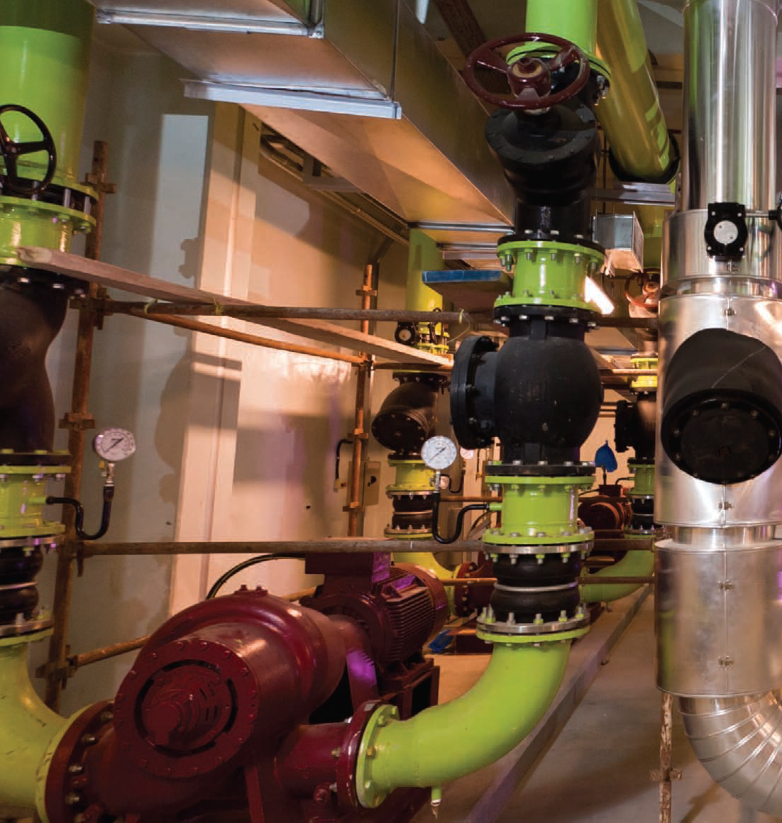

Slide 56
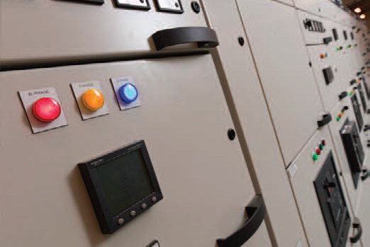

Slide 57
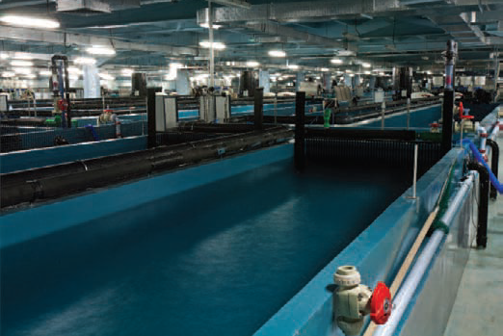

Slide 58
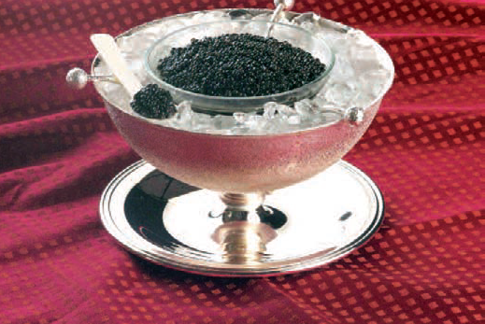

Slide 59
The next high tech centre for seafood production – in CHINA?
Introducing – in cooperation with world leading suppliers of R.A.S. technology, secure genetics, healthy quality food - and operational management skills…
…. in order to establish an industrial competence centre ensuring the future demand for volume production of healthy, secure and safe seafood products.
Start up immediately – with State of the Art R.A.S. for SALMON or FJORD SALMON.
More new high value spices like sturgeon will follow.

Slide 60
